Slide 1
Horse Race Outcome Prediction
Data Analysis and Machine Learning Approach
Name: Nithyalakshmi P
Date: 16.06.2024

Slide 2
Problem Statement
Objective:
Predict the position of horses in races using historical data.
Why Important:
Helps stakeholders make informed decisions.
Can potentially improve betting strategies and race preparations.

Slide 3
Tools Used
Programming Language: Python
Libraries:
Data Manipulation: Pandas, NumPy
Machine Learning: Scikit-learn, Imbalanced-learn (SMOTE)
Visualization: Matplotlib, Seaborn

Slide 4
Approaches
Data Collection:
Merged multiple CSV files for races and horses data.
Data Cleaning:
Handled missing values using imputation (mean/mode).
Dropped irrelevant columns.
Feature Engineering:
Converted columns to appropriate data types.
Scaled features for uniformity.
Modeling:
Linear Regression to predict horse positions.
Evaluated model using train-test split and cross-validation.

Slide 5
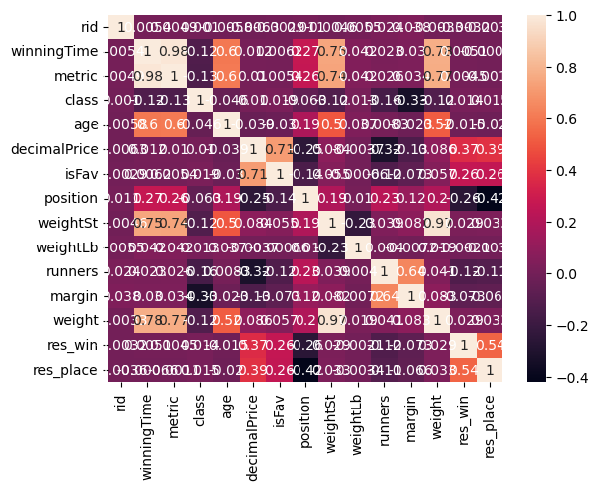
EDA Insights - Correlation Matrix
Correlation Matrix:
Visualized relationships between numeric features.
Identified potential multicollinearity issues.

Slide 6
Model Training and Evaluation
Linear Regression:
Trained on the processed data.
Evaluated using Mean Squared Error (MSE) and R² score.
Performance Metrics:
Train MSE: 0.1278
Test MSE: 0.1493
Train R²: 0.9067
Test R²: 0.8904

Slide 7
Cross-Validation
K-Fold Cross-Validation:
5 folds to ensure robust evaluation.
Average Performance Metrics:
MSE: 0.1382
R²: 0.8950
Fold-wise Performance:
Visualize the fold-wise performance.

Slide 8
Conclusion
Linear Regression model showed good performance with high R² scores.
Consistent performance across cross-validation folds.

